Slide 1
Smile Factors
A study of world happiness and the factors that cause it.
By
Charles Ryan Barrett & Ryan Bruggemann

Slide 2
Hypothesis For Happiness
Largest factors
Minor factors
Cascading factors

Slide 3
How Is Happiness Measured?
Happiness Score
GDP
Social Help/Welfare
Health
Freedom
Generosity
Perceived Corruption

Slide 4
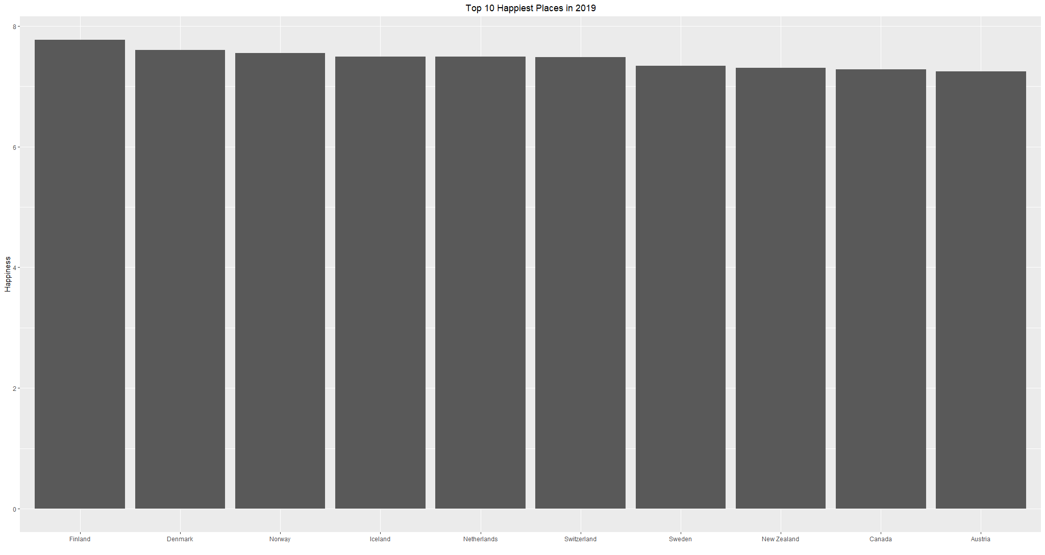

Slide 5
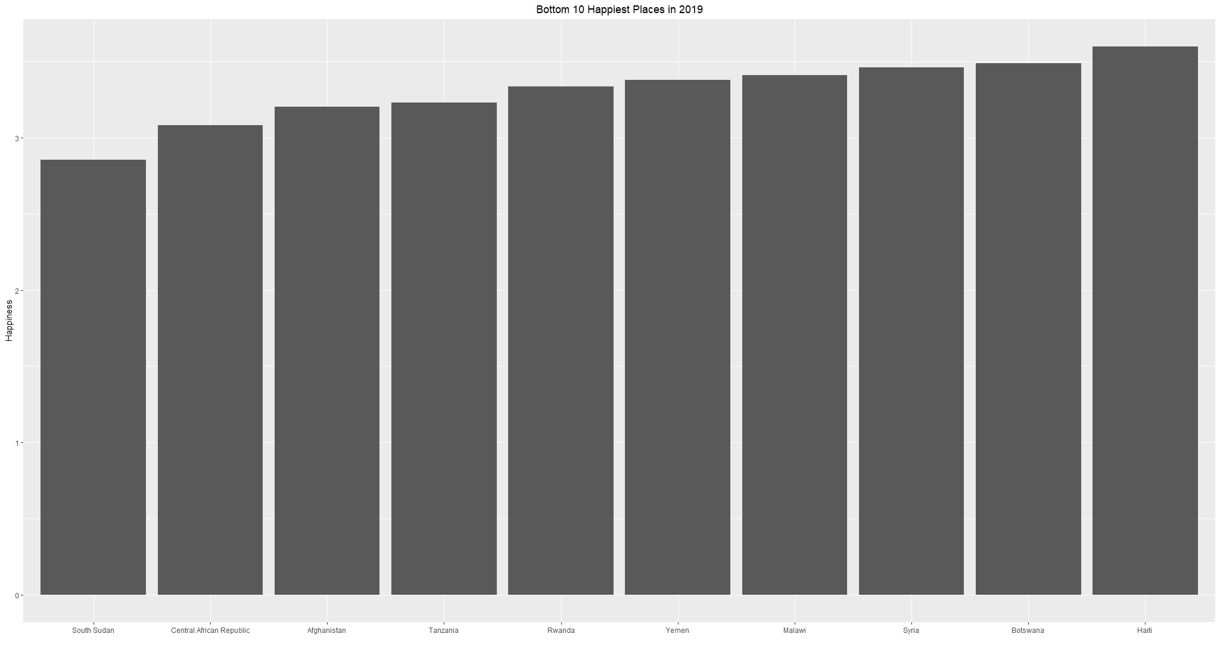

Slide 6
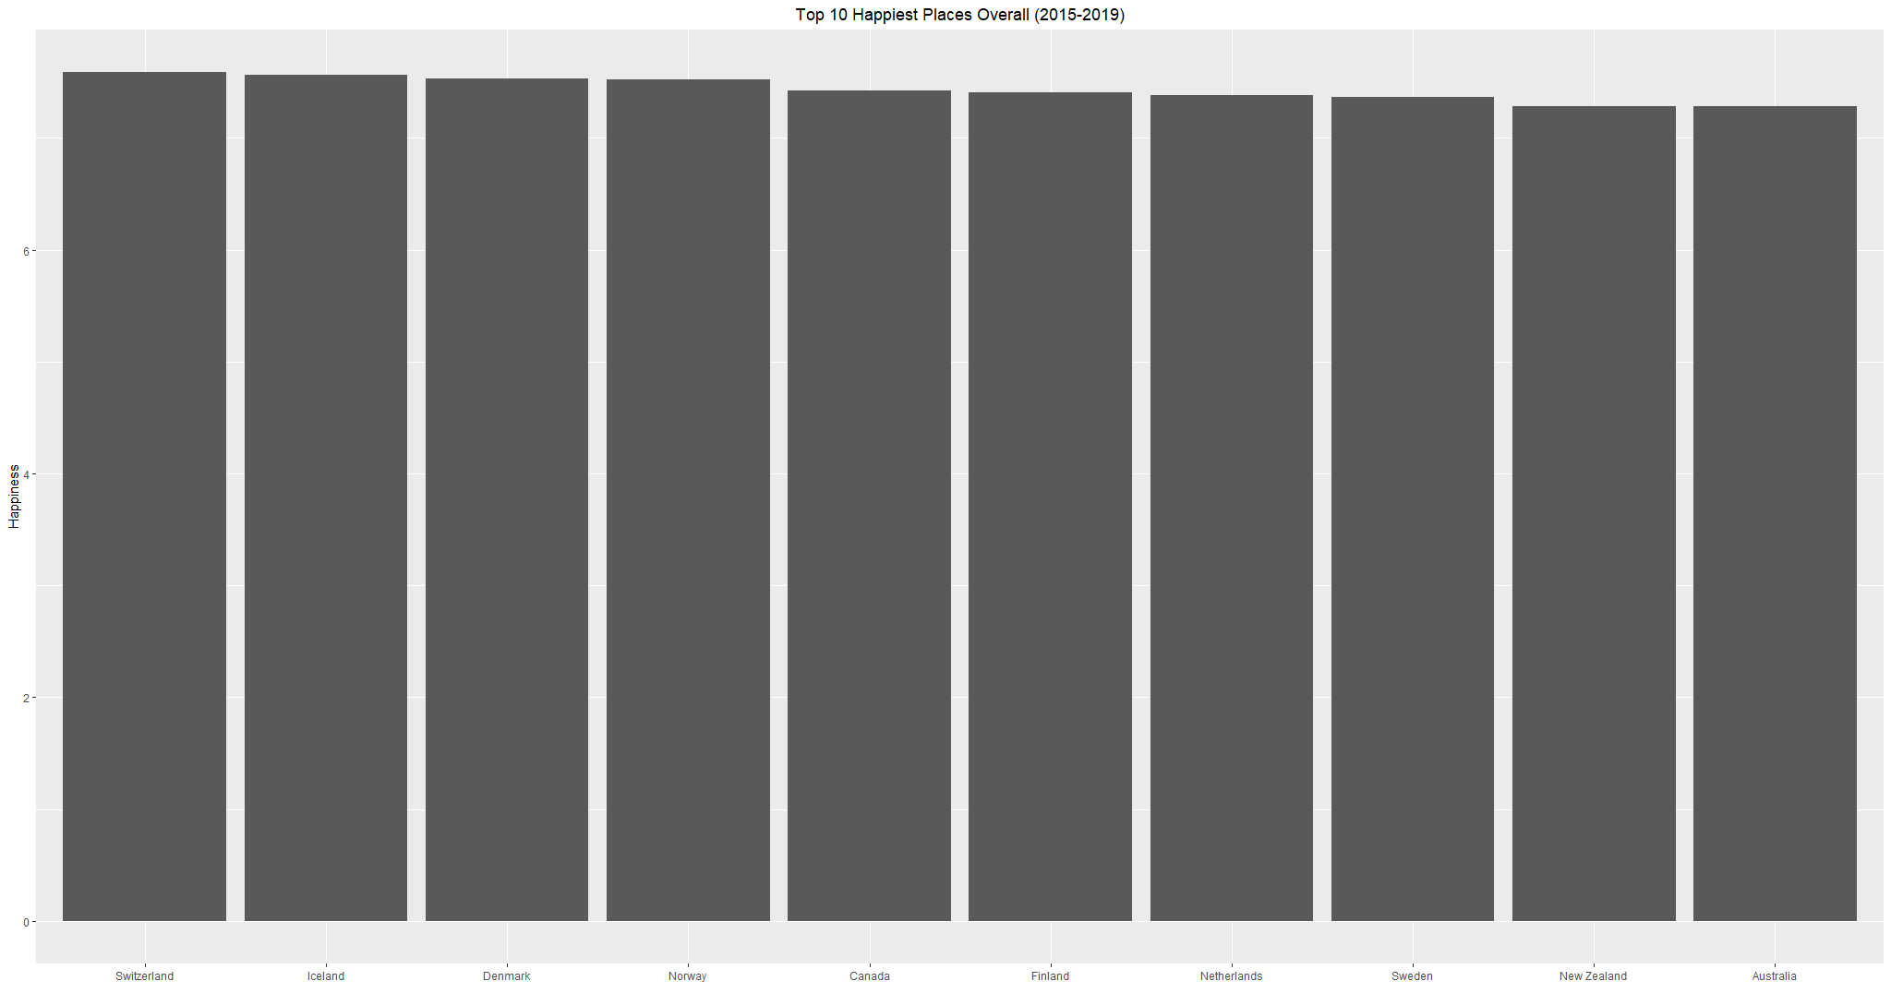

Slide 7
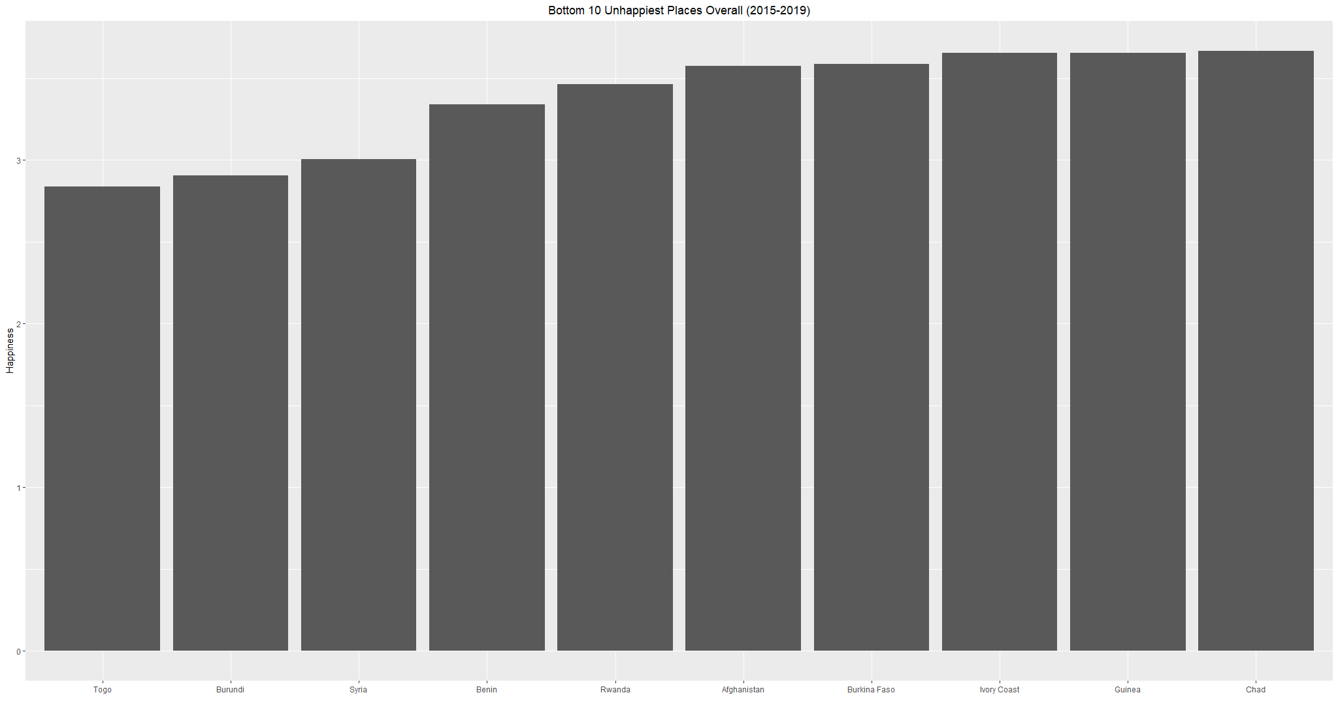

Slide 8
The Path Of The Two Tens
Methods to find changes
How they shifted
What factors determined the changes?

Slide 9
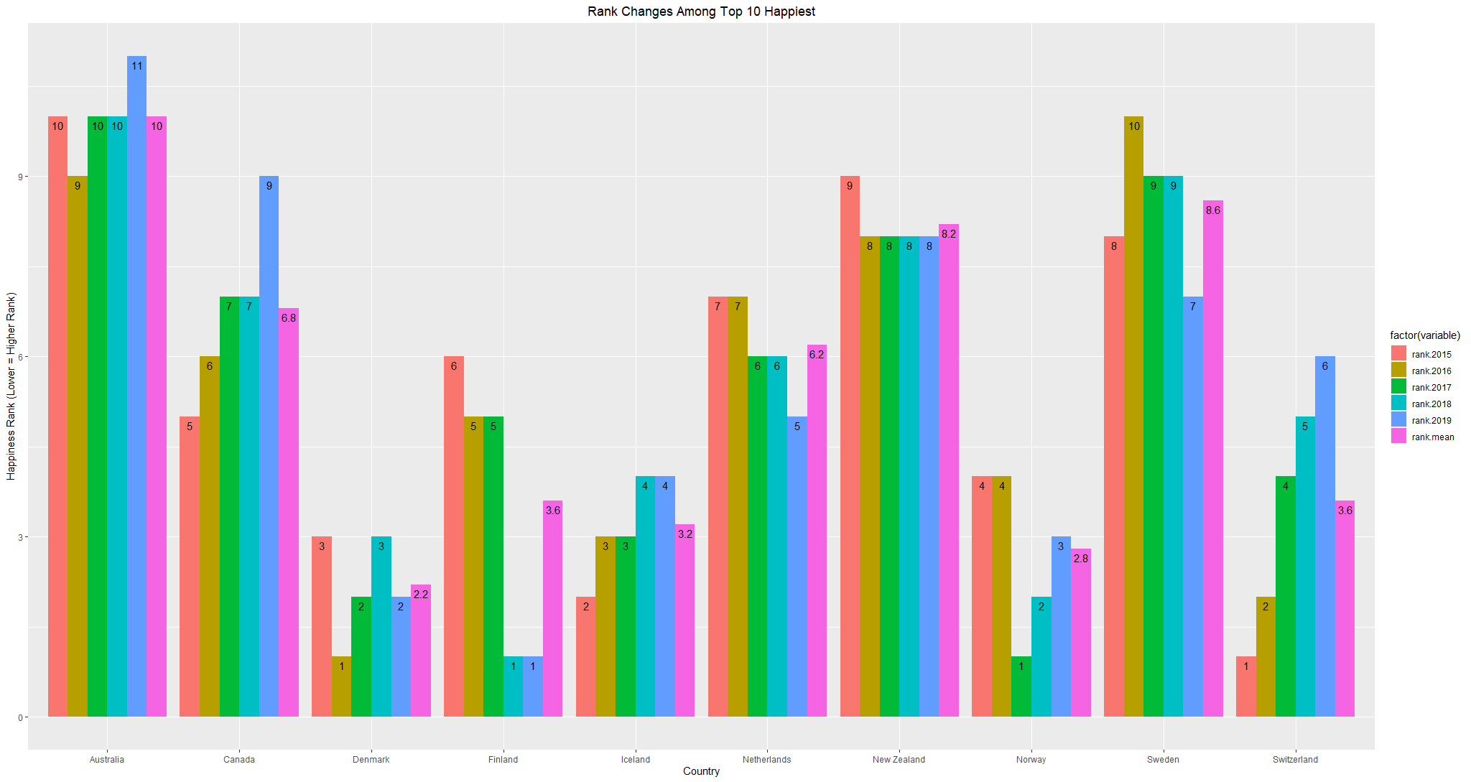

Slide 10
Changes Within The Top Ten
Most Stable: New Zealand
Highest Average Rank: Denmark
Lowest Average Rank: Australia
Largest rise: ?
Largest fall: ?

Slide 11
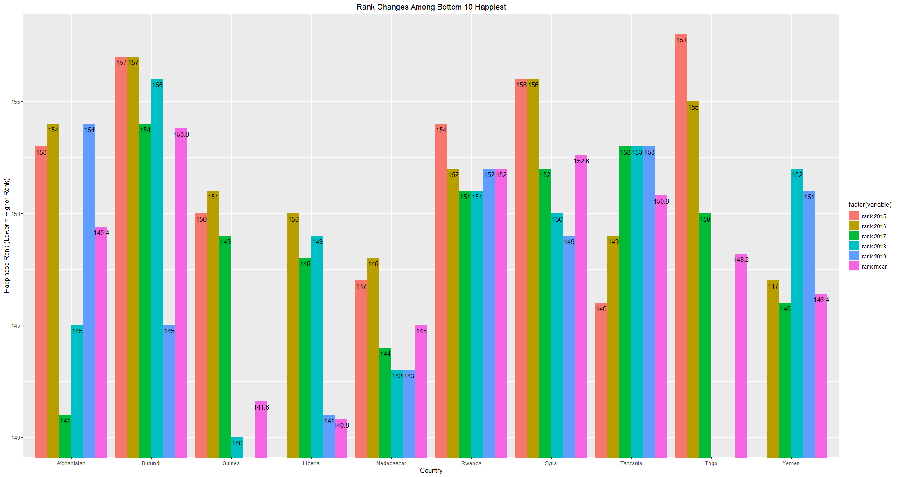
Notes:
*Note, many of the bottom happiest are more unstable. Therefore, for certain ones there are missing years of data that are affecting the overall score

Slide 12
Changes Within The Bottom Ten
Most Stable: Rwanda
Highest Average Rank: Madagascar
Lowest Average Rank: Burundi?
Largest Rise: ?
Largest Fall: ?

Slide 13
Largest Change In Rank Overall
Benin improved the most
Venezuela had the largest drop
How?

Slide 14
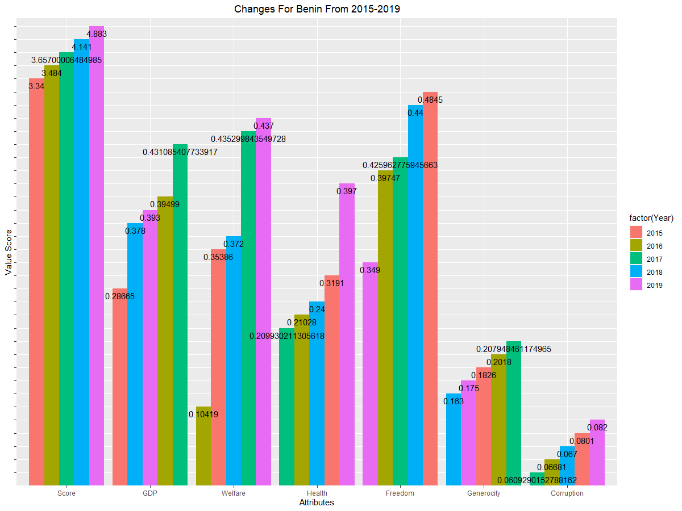

Slide 15
Changes For Benin
?
?

Slide 16
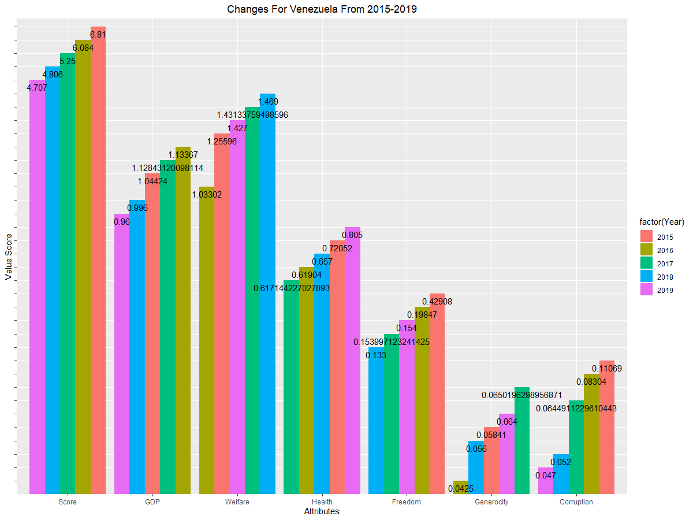

Slide 17
Changes For Venezuela
?
?

